Slide 1

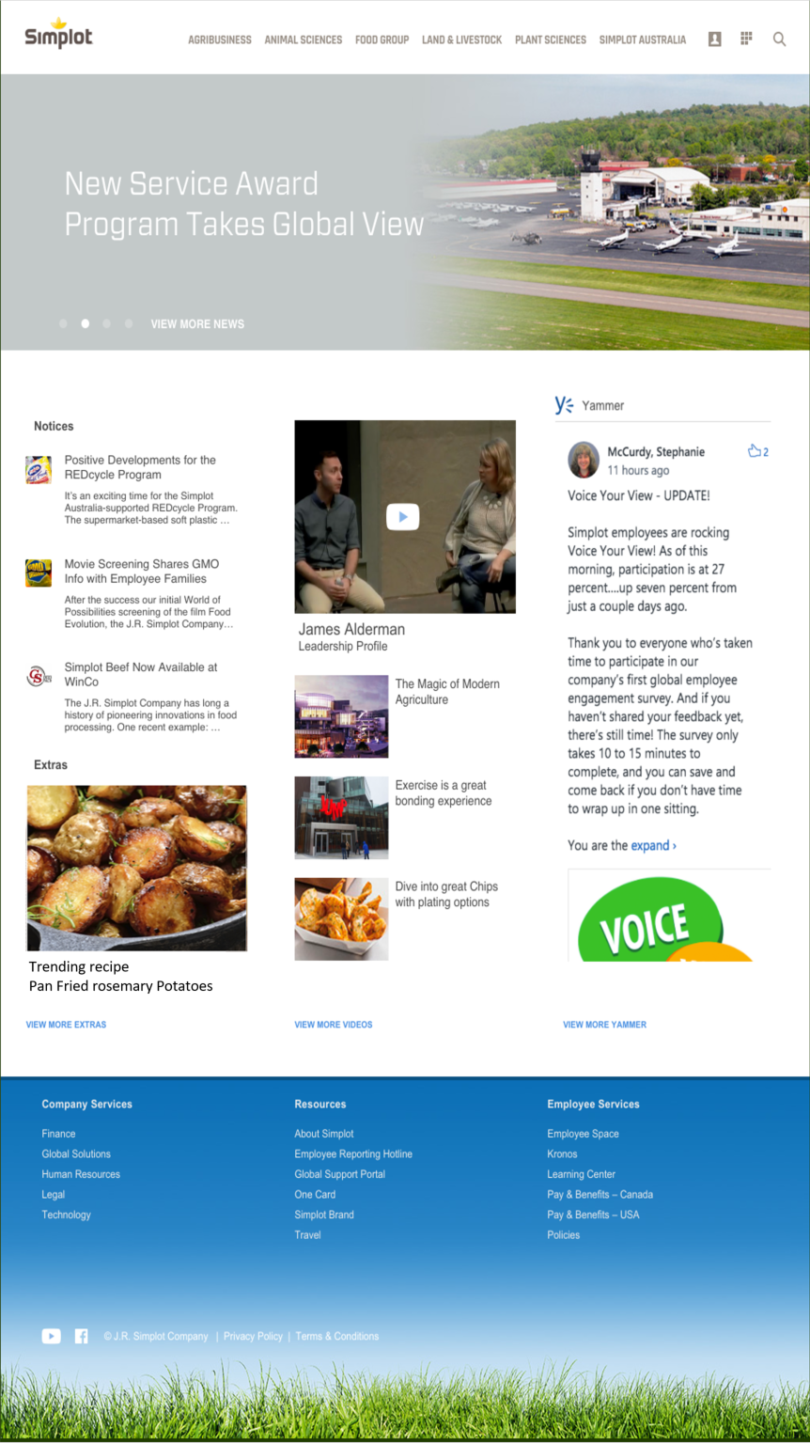
Customer facing business groups will be located at the top of every page.
A quick Tour of The Source
Easy access to all your favorite tools!
Rotating news Articles!
People Apps Search

Slide 2
The Source
New
Watch featured Videos and view more video!
Notices will vary based on location, minimizing the need for email communication.
New
Yammer feed so you can keep up with group and company conversations directly from the home page.

Slide 3
The Source
Ne
New
Extras will highlight Company products, recipes, and industry news.
Global Company Services, Resources and Employment Services are available on the footer of any page!

Slide 4
Customer facing business groups will be located at the top of every page.
The Source
Easy access to all your favorite tools!
Rotating news Articles!
People Apps Search
New
Watch featured Videos and view more video!
Notices will vary based on location, minimizing the need for email communication.
New
Yammer feed so you can keep up with group and company conversations directly from the home page.
Extras will highlight Company products, recipes, and industry news.
Global Company Services, Resources and Employment Services are available on the footer of any page!

